Slide 1
CS Task 2: SE Process

Slide 2
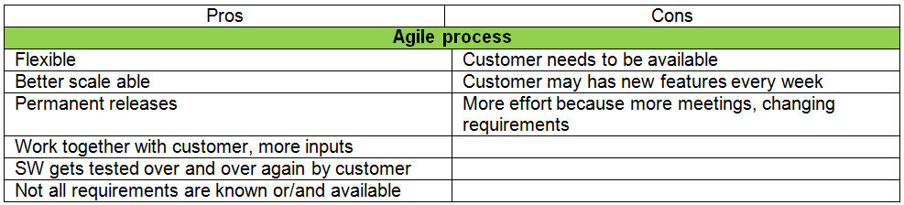
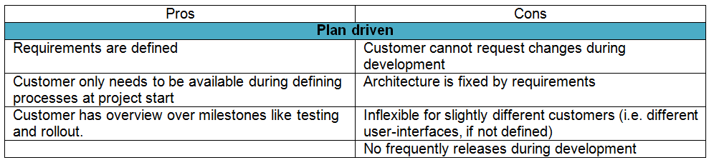
Plan Driven vs Agile

Slide 3
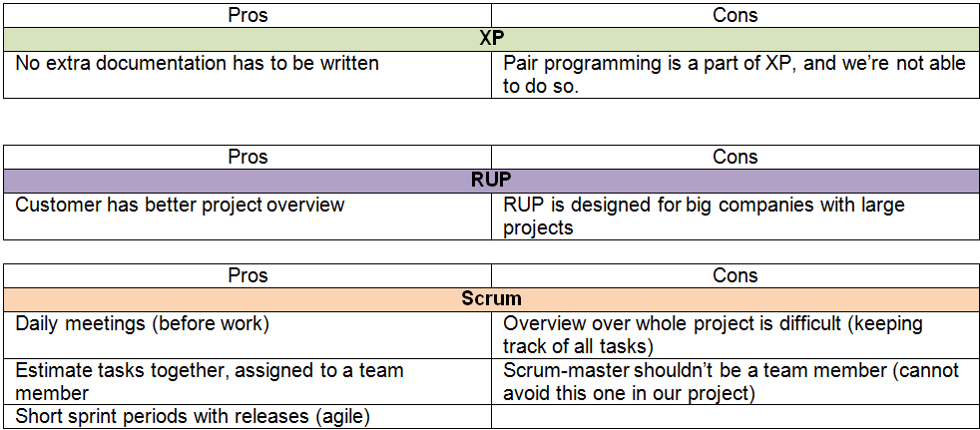
Decision SE Process Model

Slide 4
Design – Model / Activities
Decision:
Scrum
Activities:
Choose scrum master
Define requirements
Define stories for backlog
Define tasks/subtasks for stories
Decide which stories will be used in first sprint
Relations:
All the activities have to be done in serial order. After first sprint there is a review and a planning meeting for sprint two.

Slide 5
Design – Involvement
Customer:
Requirement definition
Sprint review
Sprint planning
Final release and debriefing
Development team:
Scrum meetings
Development
Management
Controlling
Users
Testing

